Slide 1
ENSE 470 - Milestone 4
Group Name: GLHF
Group Members:
Vincent Chan
Thiago De Melo
Shuaihao Zhao
Joe Emmanuel Samano
March 1, 2018

Slide 2
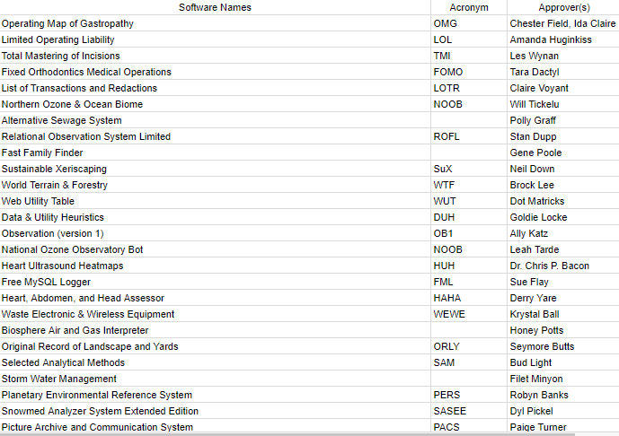

Slide 3
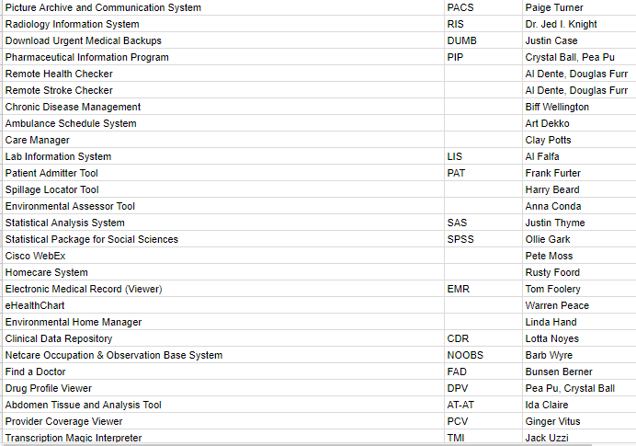

Slide 4
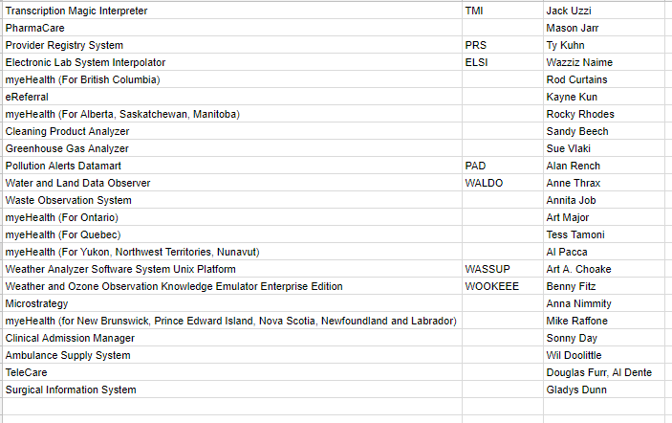

Slide 5
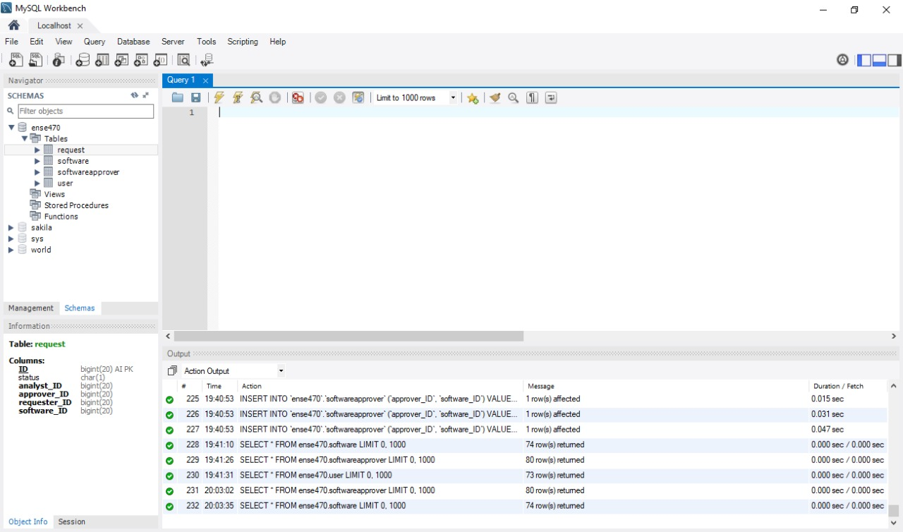
Notes:
Thiago

Slide 6
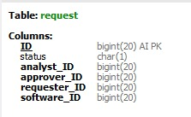
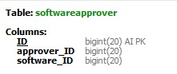
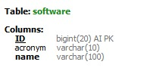
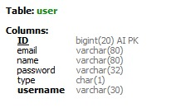
Database snapshot
Notes:
Thiago

Slide 7
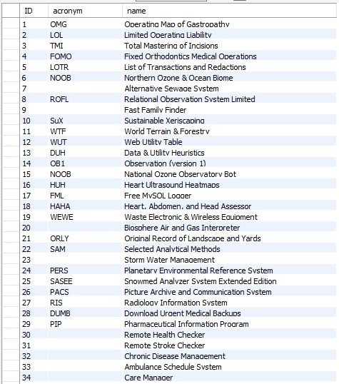
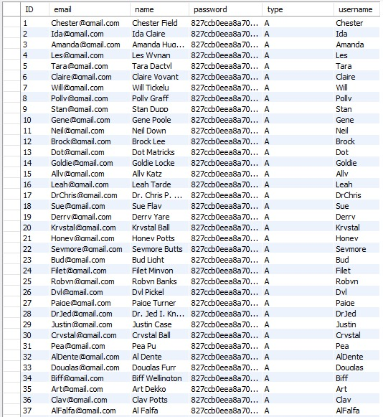
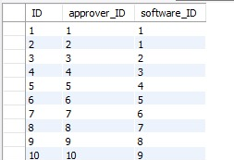
Insert tables and erd
Notes:
Thiago

Slide 8
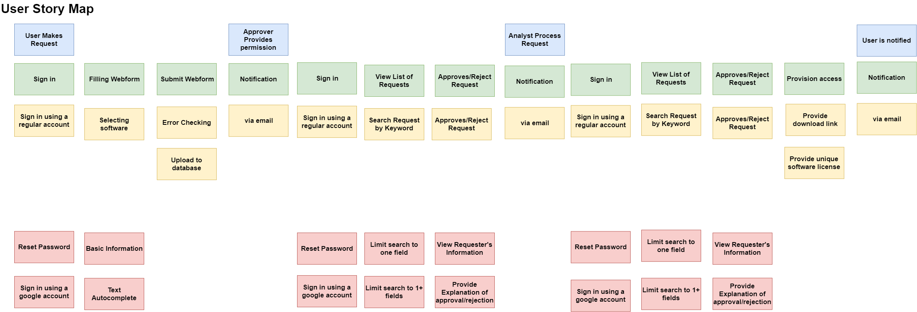
Release 1
Release 2
Notes:
Hao

Slide 9
Lo-fidelity prototype snapshots

Slide 10
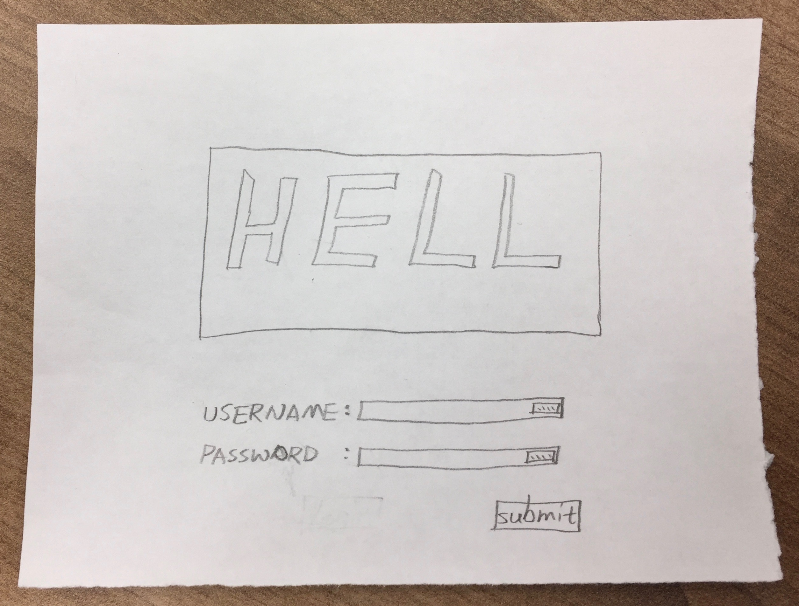
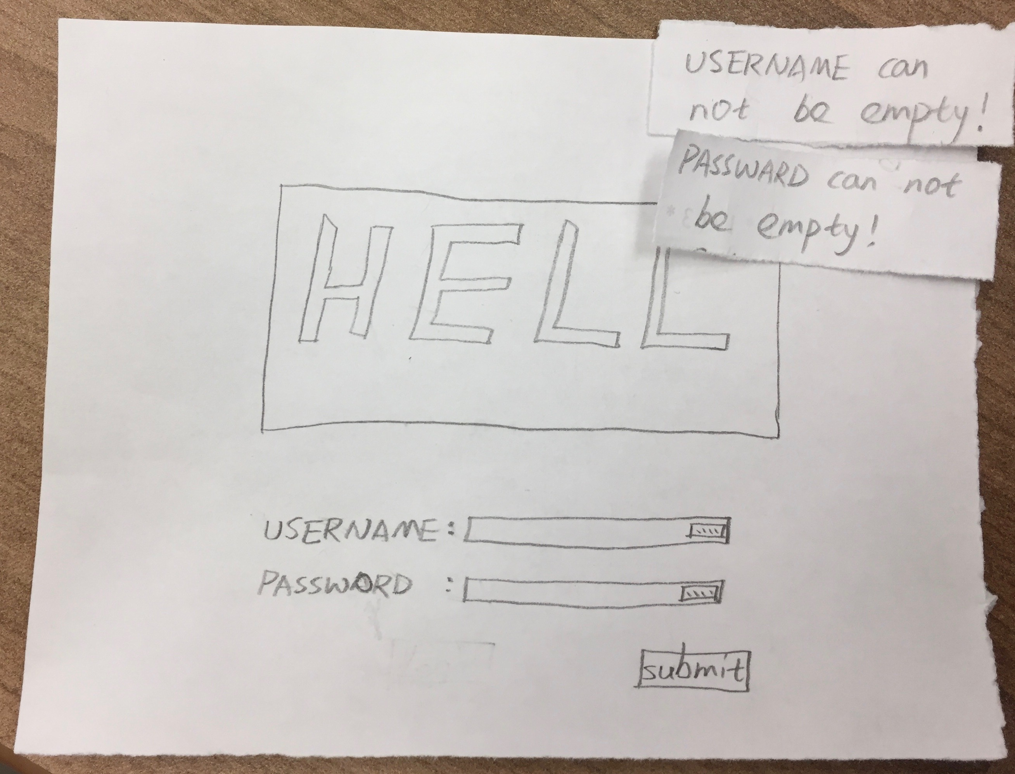
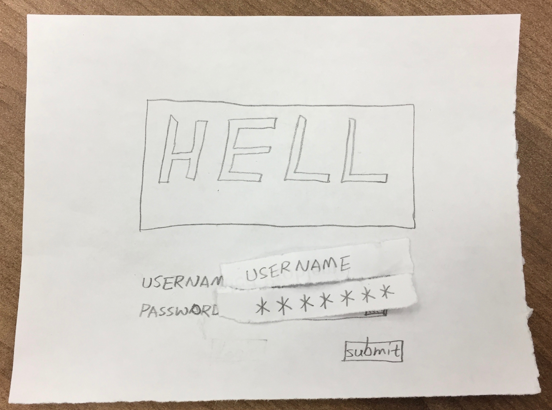
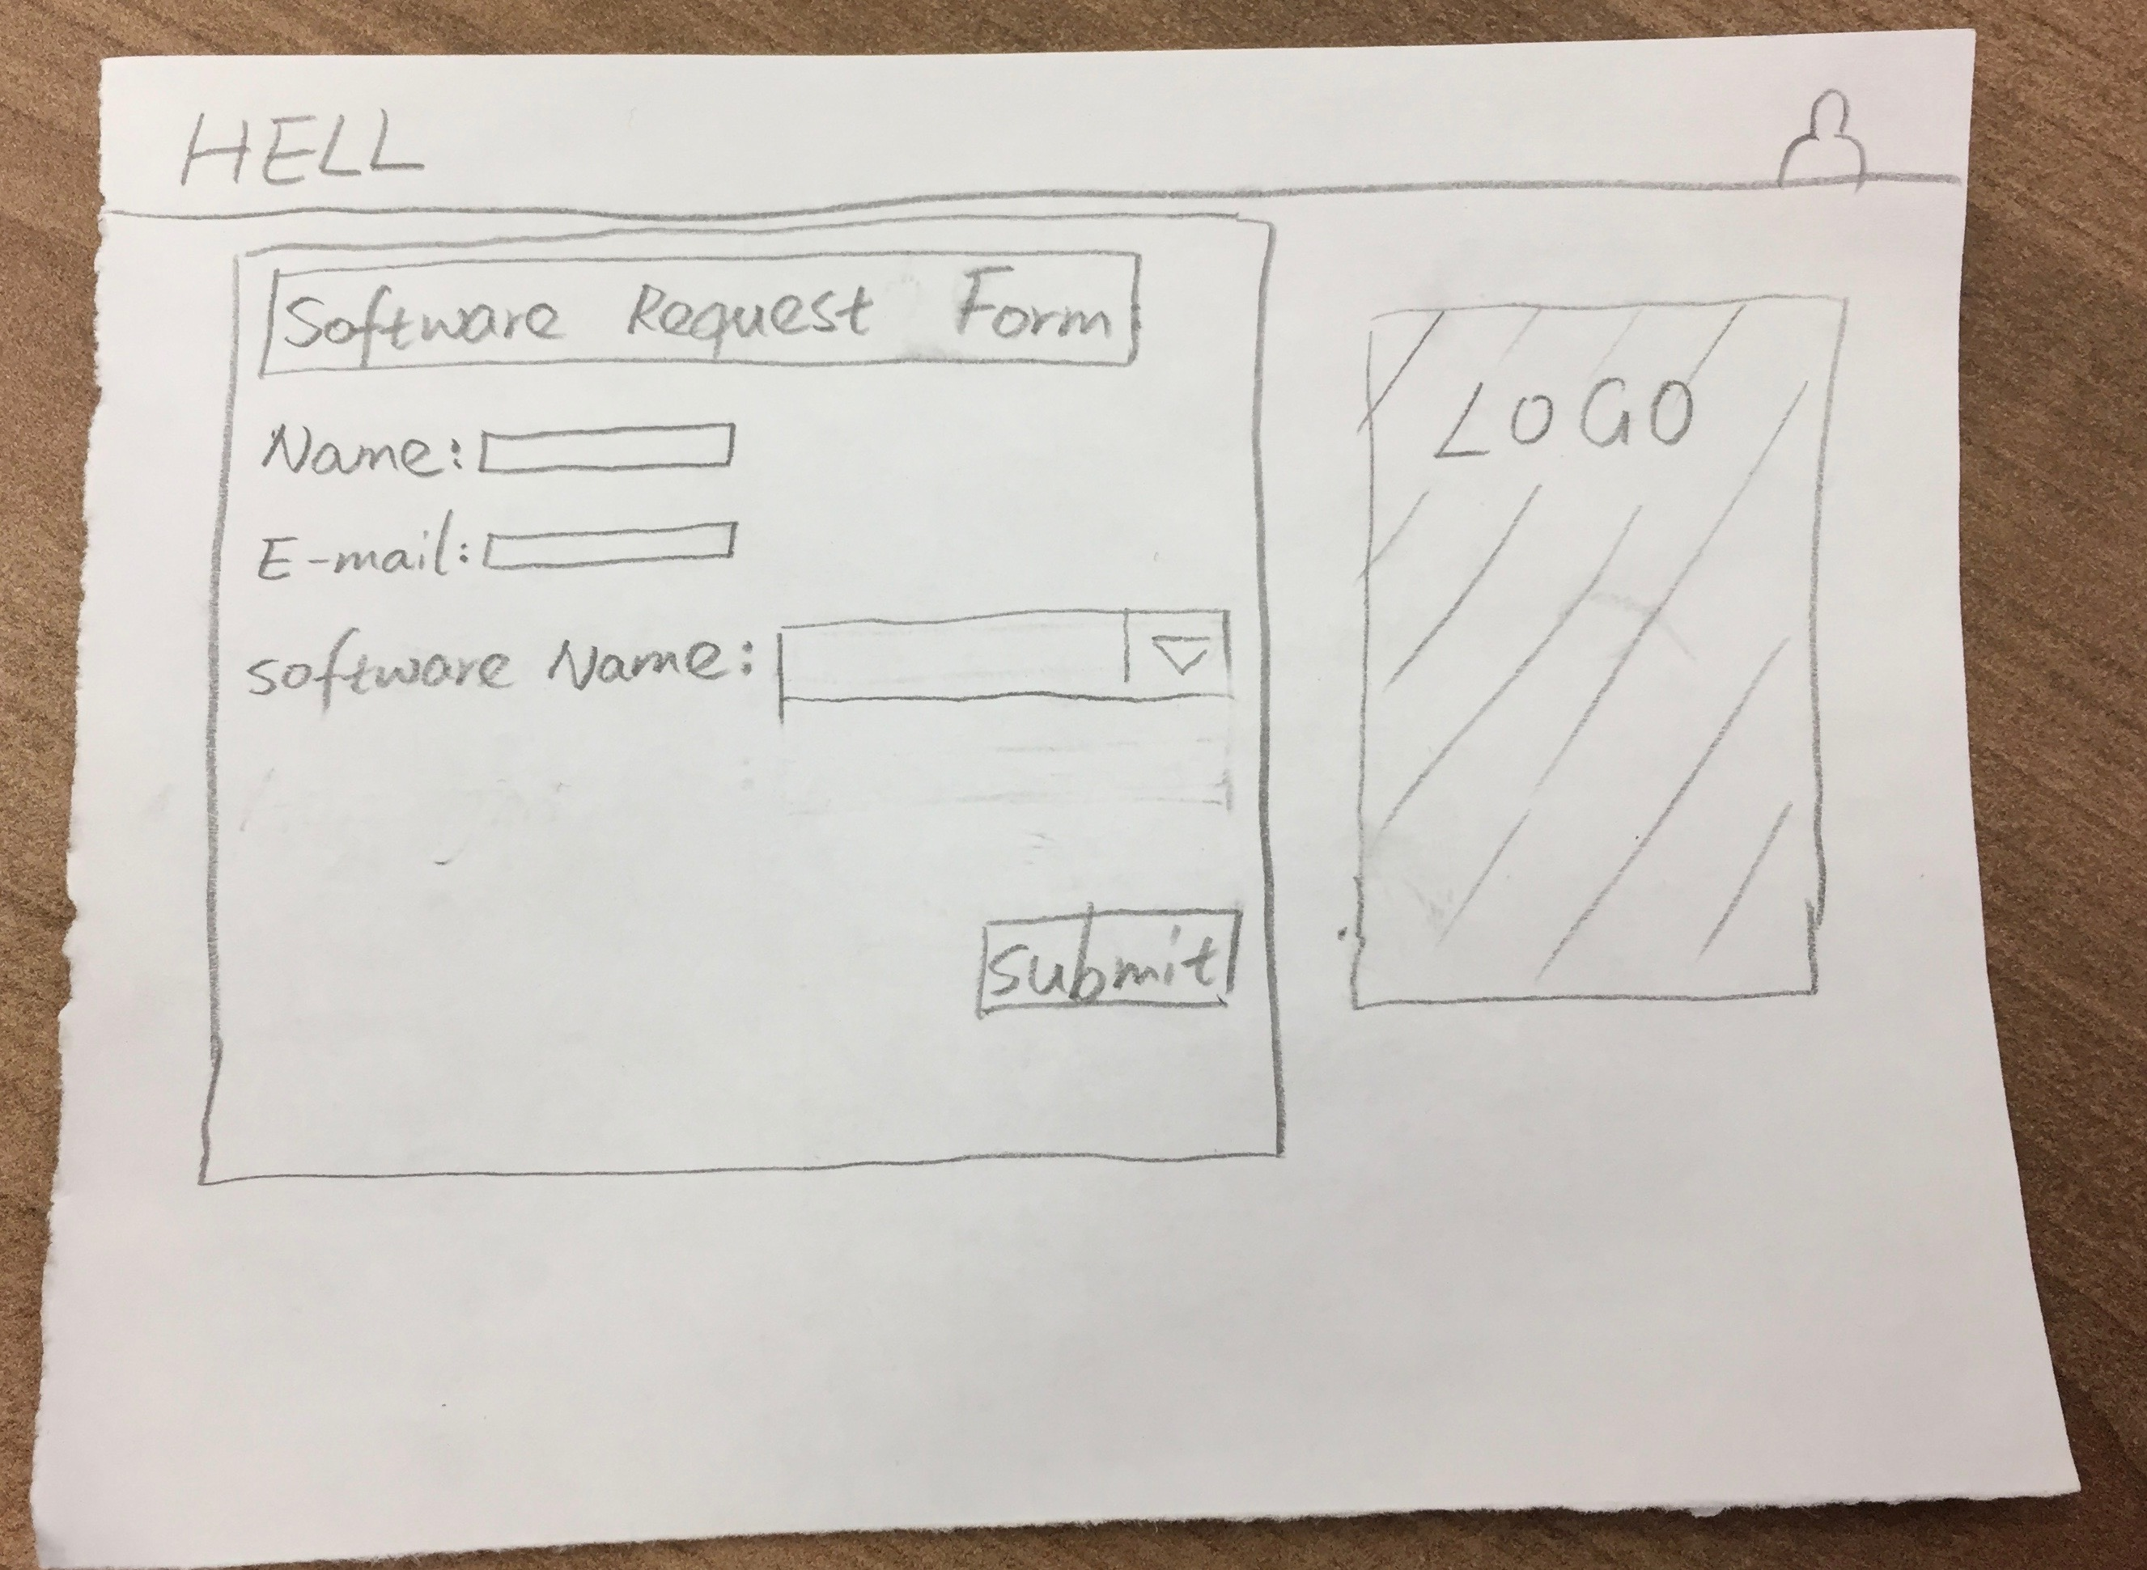
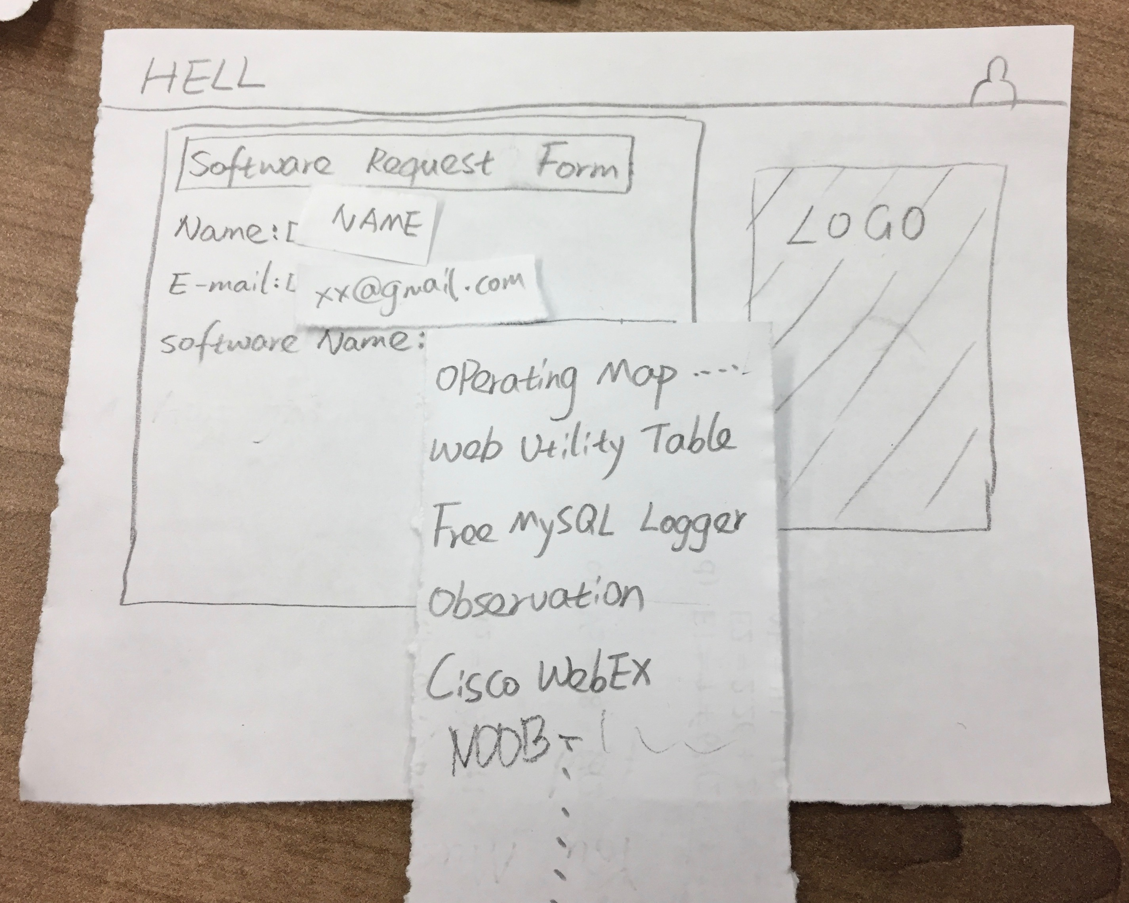
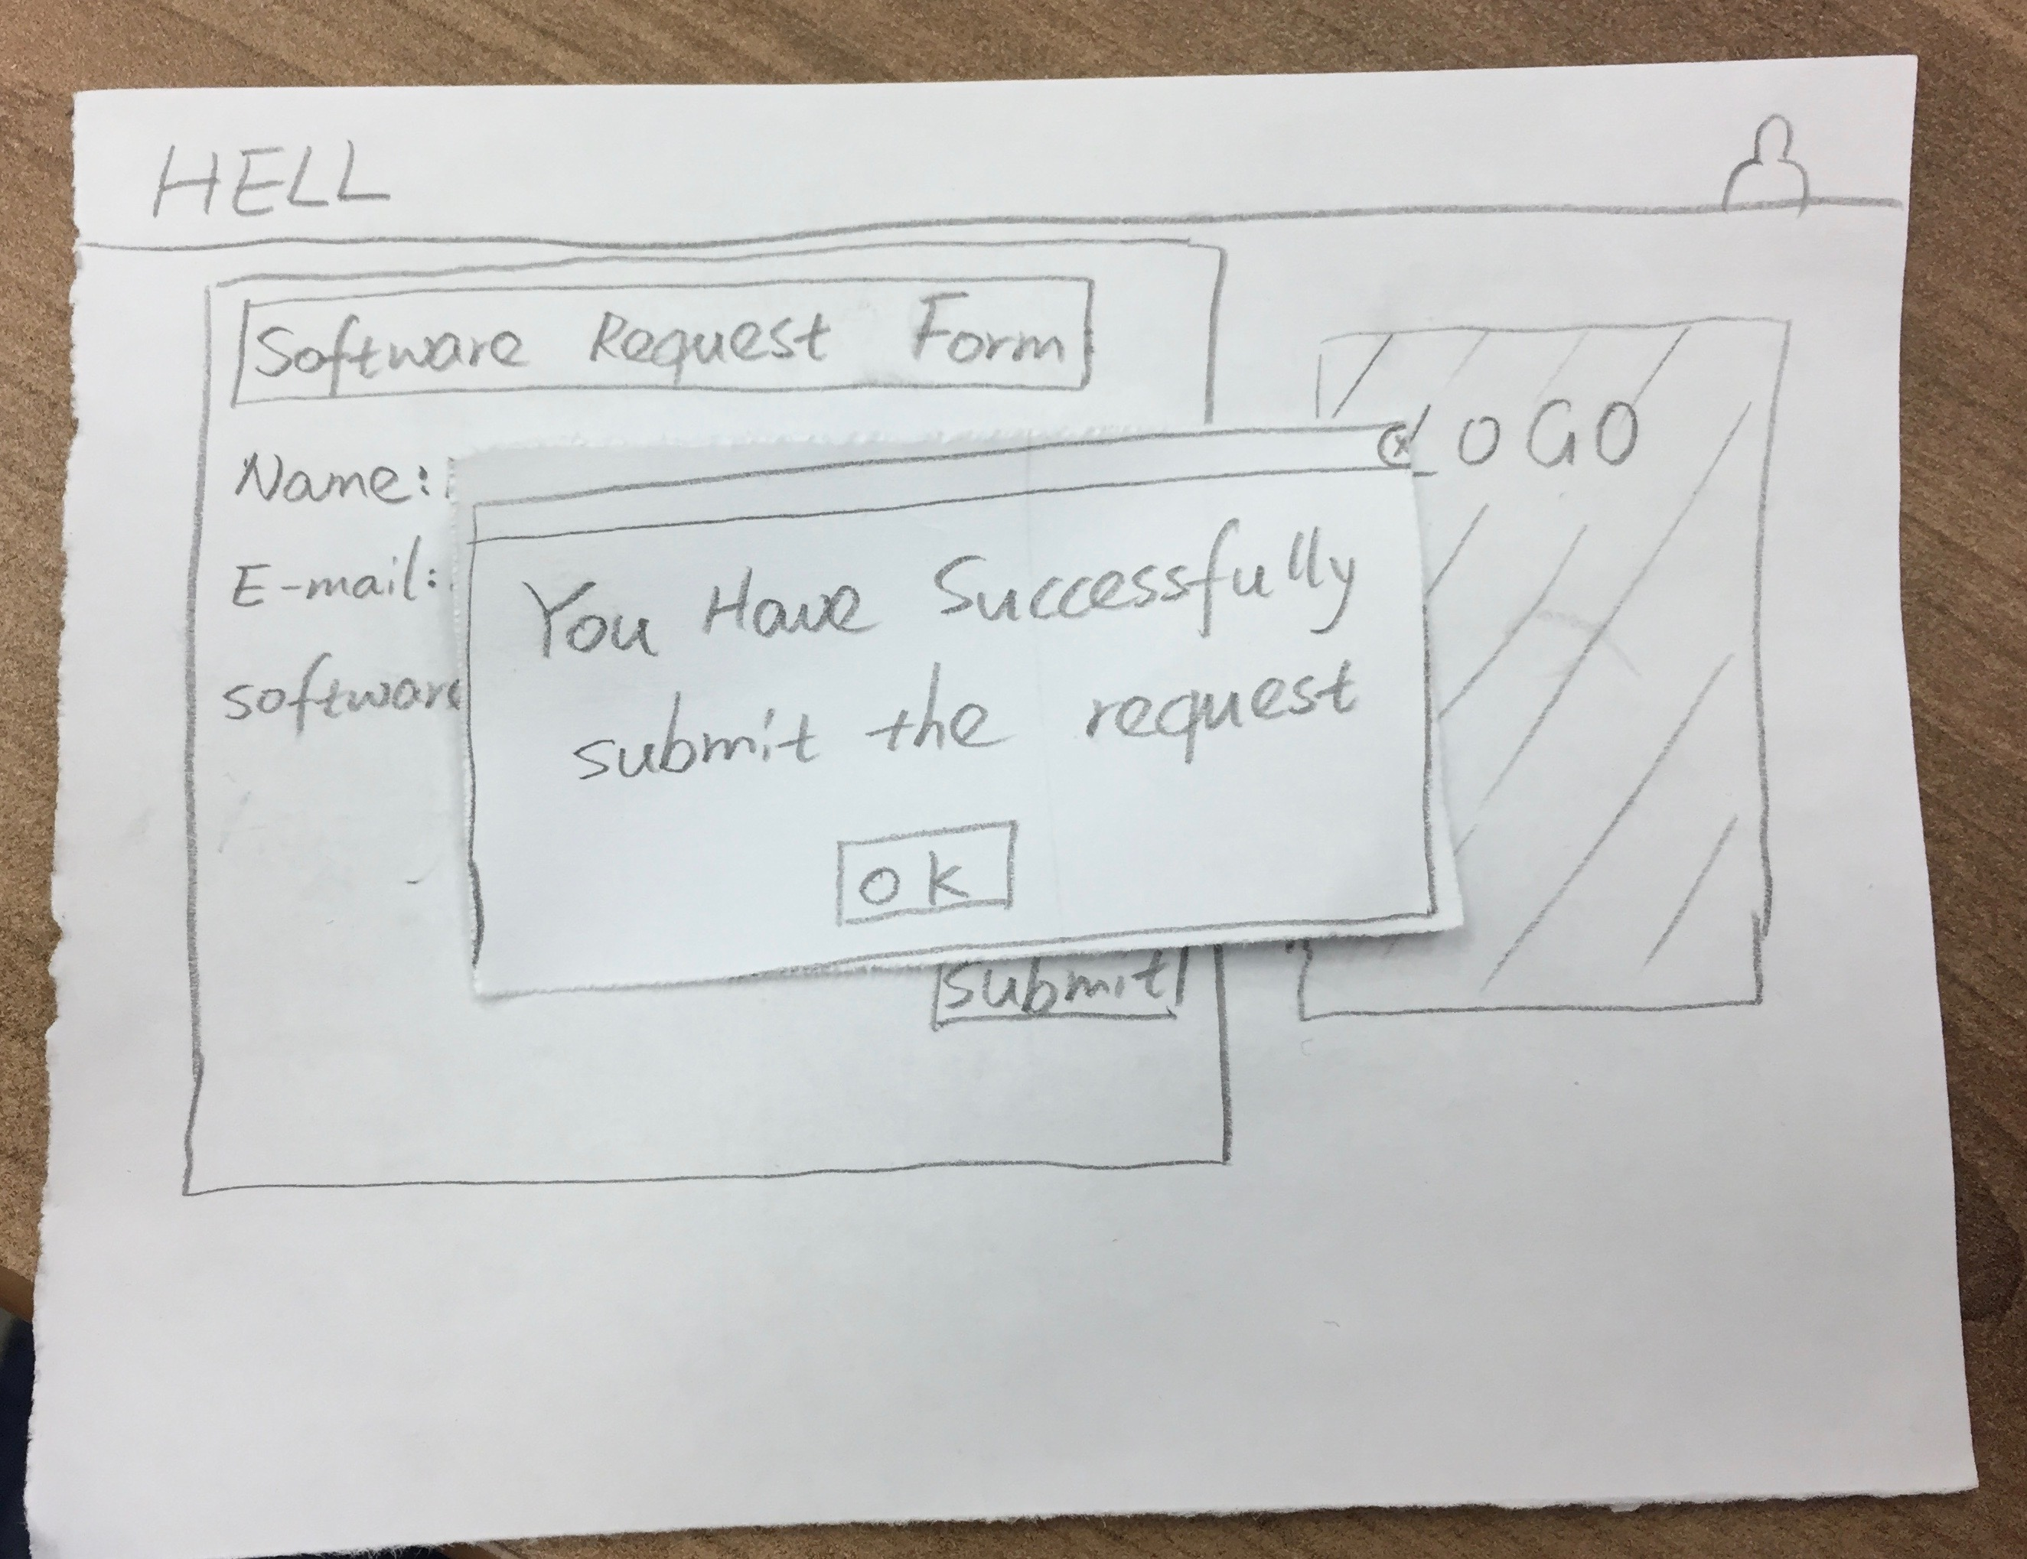
Notes:
Vincent

Slide 11
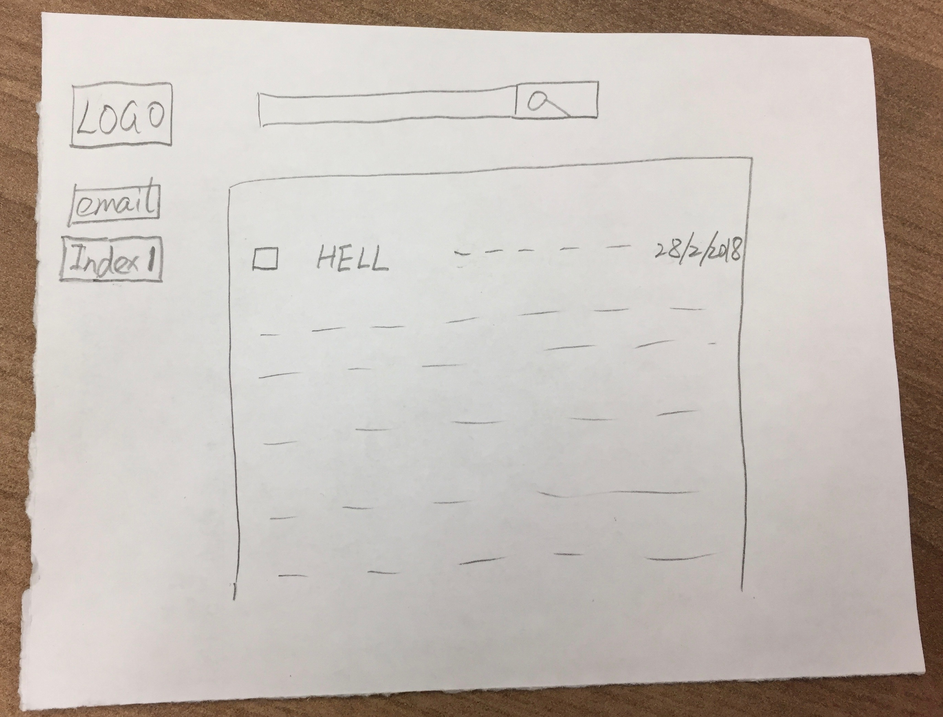
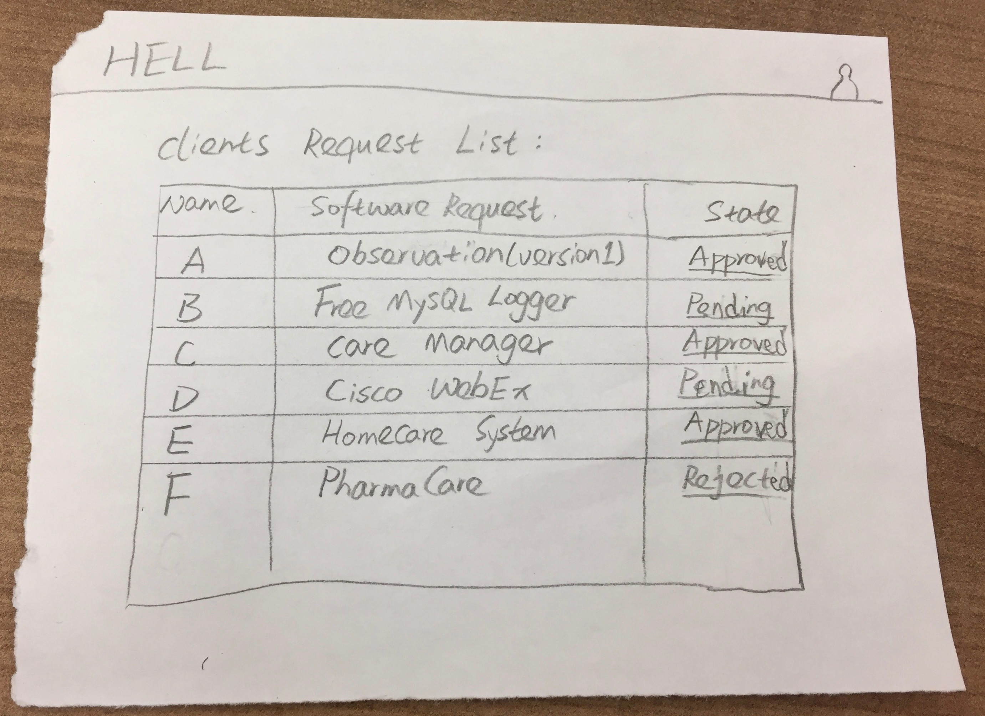
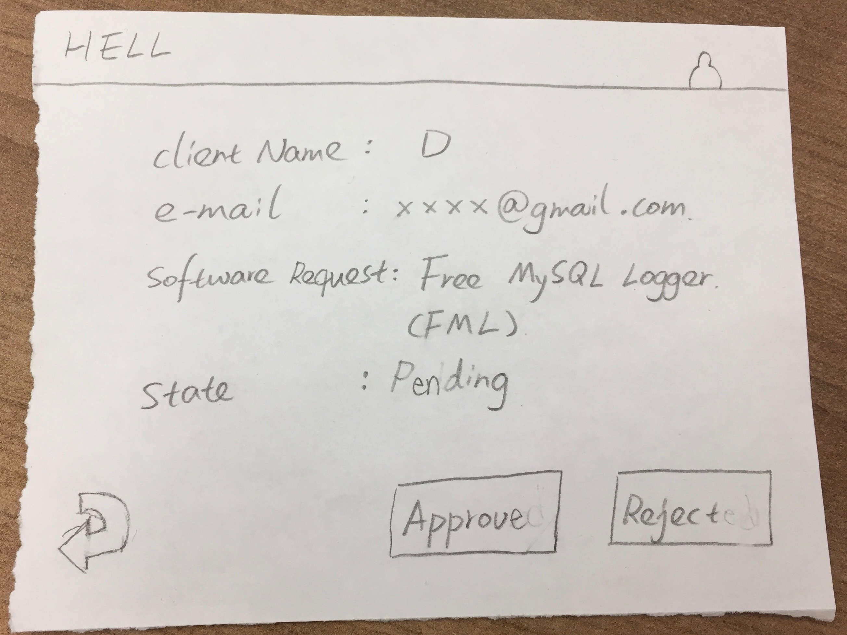
Notes:
Joe

Slide 12
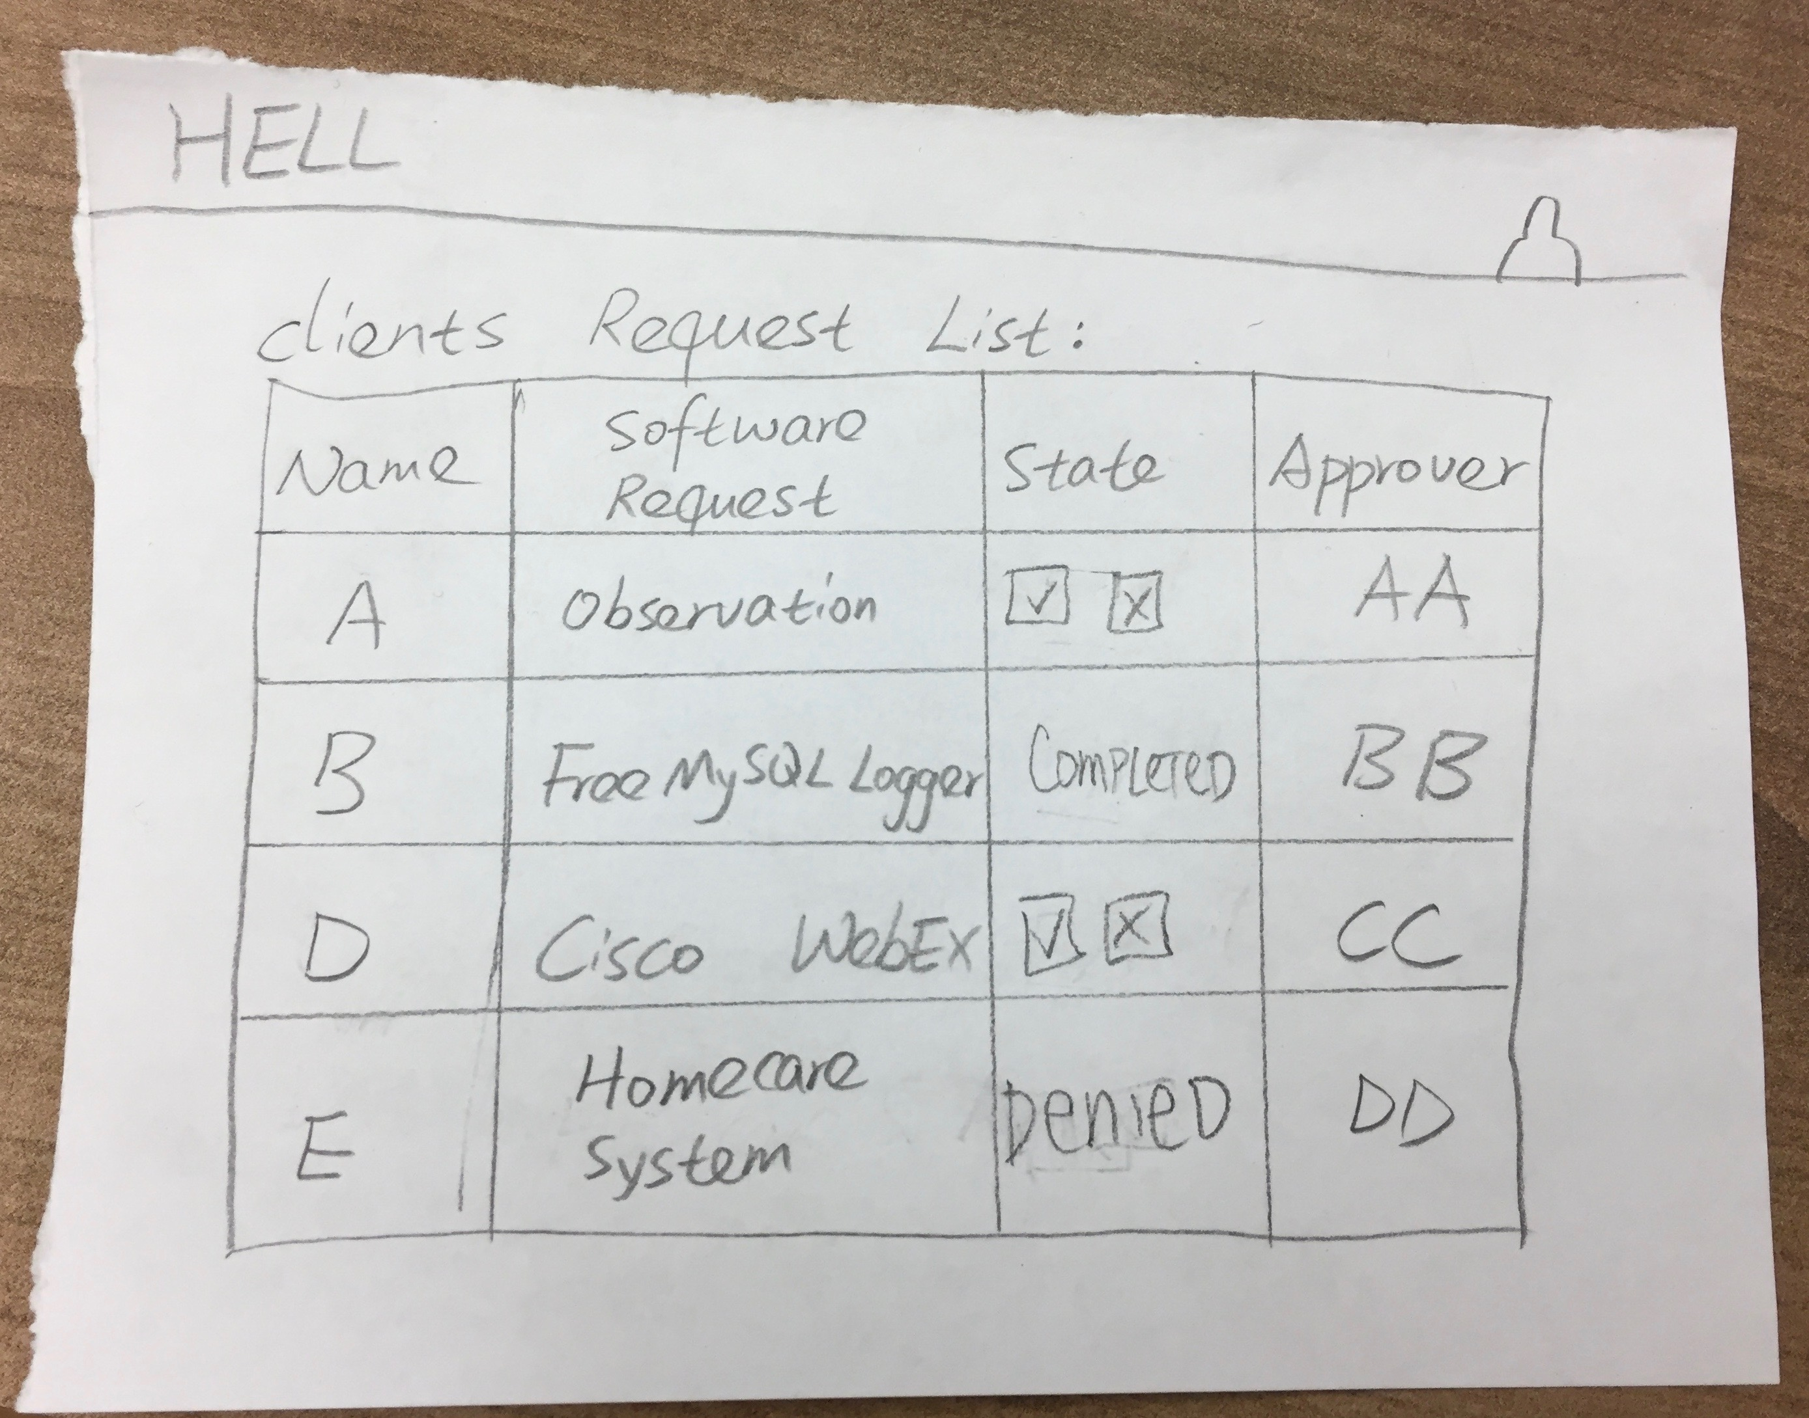
Notes:
Joe

Slide 13
Group Reflection
How did you feel about this milestone? What did you like about it? What did you dislike?
It was a lot more detailed work compared to previous milestones.
Our project became a lot more clearer when we did low-fidelity prototyping.
What did you learn about yourself as you collaborated and worked through this milestone?
We learned how to divide the work between us based on our specialties.
We learned low-fidelity prototype skills.
How will you use what you have learned going forward?
Helps to design a highly flexible design
What “stuff & things” related to this milestone would you want help with?
Having an easier way to make the lo-fi prototypes
Notes:
Joe

